Slide 1
Summary Report for BFX–UA300
Quality Issue on 2022.05 Product
Prepared by: Rachel Ruan
Reviewed by: Toney Tu
Approved by: CB Lin
Date: 2022-Aug-04

Slide 2
Issue Description
30-June-2022, ALT customer complain [BFX-UA300] 2022.May Mass production issue.
Overall inspection result => Fail ( Waived, due to product launch schedule )
Defect Total:
•Critical
Status LED not work * 1 pcs/200
Ethernet unstable * 1 pcs/200
No sound output * 1 pcs/200
•Major
No screen after booting animation. * 1 pcs/200
Cosmetic damage * 1 pcs/200
•Minor
Screw assembly * 1 pcs/200
Tact feeling is not good * 1 pcs/200

Slide 3
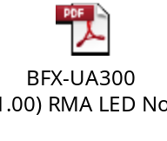
1. LED not work
Issue Description | FA | Root cause | Actions | Status
Symptom: Led not work Defect unit Q’ty : 1/200pcs Defect rate : 0.5% SKB SN: 2149695001202201006480 | 1. LED function tested at FT1 station (With factory software) and RC1 station ( With customer software) ➔This issue can cover at FT1 & RC station. 2. FA - Take X-ray and VI D22 location → Normal. - Measure impedance of D22 location → Normal. - Measure voltage of D22 location → Have abnormality on pin 1,2,3. - Swap verification between D22 NG sample and D22 OK sample. | This issue follow LED D22 component. P/N: 123.00701.005 Vendor: Everlight D/C: 210914 | Everlight had received NG sample on July-30. FII rejected the Everlight FA report on Aug-03, due to Everlight didn’t find out the root cause, waiting vendor update. Due date: Aug-05 | Ongoing

Slide 4
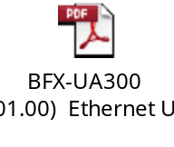
2. Ethernet unstable
Issue Description | FA | Root cause | Actions | Status
Symptom: Ethernet unstable Defect Q’ty: 1/200pcs Defect rate: 0.5% SKB SN: 2149695001202201006508 | Check FATP data → Product test pass normally. At PT station: test program will test Ethernet CRC and throughput → This issue can cover at PT station. Check VI and take X-ray Ethernet block → Normal. Measure impedance and voltage of Ethernet block → Normal. Use oscilloscope to measure crystal frequency → Normal. Check ping → Normal. Retest NG unit at OBA → Ethernet unstable, Ethernet speed too low. Re_solder U801 and retest OBA → Still NG. Replace a new U801 and retest PT & OBA → Pass | This issue follow PER IC U801. P/N:002.02152.005 Vender: Realtek Date code: 2152 | Sent the U801 NG material to vendor REALTEK for further analysis on Jul-26. And vendor received the NG samples on Jul-29. Realtek will provide the 8D report on Aug-12. (SQE: Ms. Naomi, Due date: Aug-12 | Ongoing

Slide 5
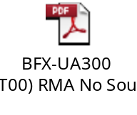
3. No sound output
Issue Description | FA | Root cause | Actions | Status
Symptom: No sound output Defect Q’ty: 1/200pcs Defect rate: 0.5% SKB SN: 2149695001202201006507 | 1. Sound function tested at FT2 station (With factory software) and RC1 station ( With customer software) ➔ This issue can cover at FT2 & RC1 station. 2. Visual Top & Bot side of NG sample → Repaired at 5R67,5R68, R108 locations and solder more jump at 2con1 location. 3. Take X-ray U1, RAM, Flash → Normal. 4. Measure the impedance at the position of the resistors next to J813 → Found out abnormal. - Retest FT2 & OBA station → Pass 5/5 times - Power on and play music by external internet within 3 hours ➔ Normal - Power on/off ( on 3minutes, off 30s) to check sound output ➔ Normal. | Customer repaired 5R67,5R68, R108 locations, but the function is OK. FII judged it’s NTF issue. | FII will keep monitor this issue. | Monitor

Slide 6
4. No screen after booting animation
Issue Description | FA | Root cause | Actions | Status
Symptom: No screen after booting animation Defect Q’ty: 1/200pcs Defect rate: 0.5% SKB SN: 2149695001202201007918 | Check FATP data → normally. →At RC1, RC2 station: test program will check QR code and display remote capture when product finish booting. → This issue can cover at RC1, RC2 station | → This issue has happened before and Customer FW: 19.532.16 has bug. → Confirmed with RD and customer this issue and they still not provide method to fix it. | Short term: Factory will re- download customer FW 19.532.16 to solve this case. Long term: Continue to work with RD to find a method to fix this issue | Monitor

Slide 7
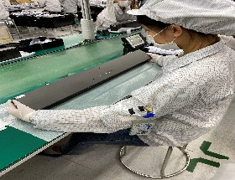
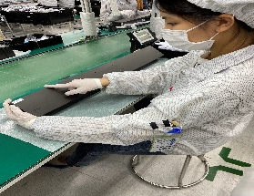
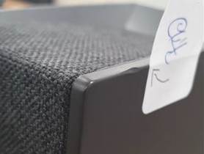
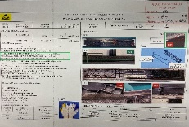
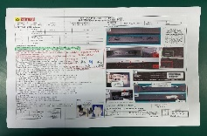
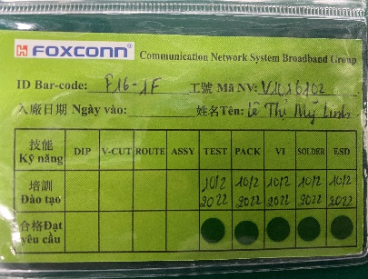
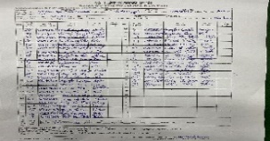
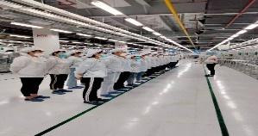
5. Cosmetic damage
Issue Description | Root Cause | Actions | Status
Symptom : Dented on the side of the top case Defect Q’ty: 1/200 pcs Defect rate: 0.5% | The May-2022, online had defect Top housing had damage when OP open housing carton check visual before assembly. We had inform to Inkel vendor notice this issue and request Inkel sorting before ship to Fii. On production line, OP no check careful housing TOP case had damage. Visual Inspection station: OP - V1001210 Nguyen Thi Hong -Line 9. | 1. Re-training OP check housing incoming and assembly, VI . Status : Done 2. Update NG picture to SOP and Hang quality alarm on this station for OP notice it. Status: Done 3. Before run line , line leader training OP, notice quality online issue, IPQC defect issue, OBA issue, read SOP and quality alarm. Status: Done | Closed

Slide 8
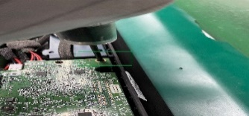
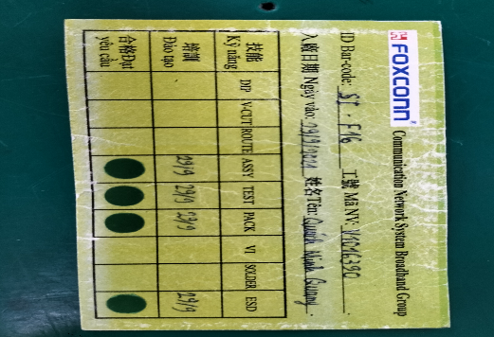
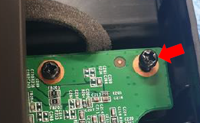
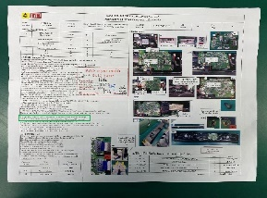
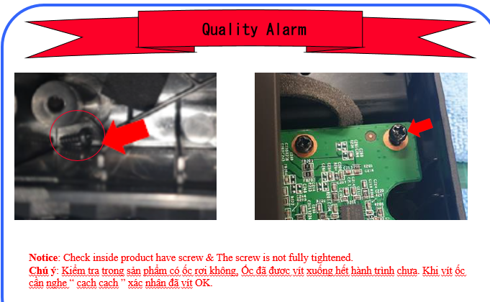
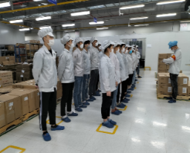
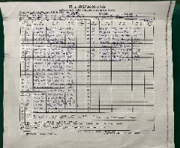
6. Screw assembly
Issue Description | Root Cause | Actions | Status
Symptom: The screw is not fully tightened Defect Q’ty: 1/200 pcs Defect rate : 0.5% | 1. OP assembly AMP main doing no follow SOP, Screw need confirm by 2 “cach cach”. 2. OP no re-check by himself before transfer to next station. 3. OP doing this station : V1016390 Quach Minh Quang. | 1. Re-training OP doing follow SOP. Status: Done 2. Update NG picture to SOP. Quality alarm hang online for OP notice it. Status : Done 3. Before run line , line leader training OP, notice quality online issue, IPQC defect issue, OBA issue, read SOP and quality alarm. Status : Done | Closed

Slide 9
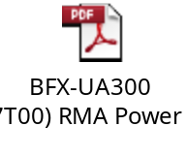
7. Tact feeling is not good
Issue Description | FA | Root cause | Actions | Status
Symptom : Power button tact feeling is NG PCBA check : one tact switch feels NG in PCBA level. | 1. Check FATP data SN ➔ normally. 2. Check Visual inspection and X-Ray all is normal. 3. Check by Mustimeter display connection is OK. 4. Reassemble Button main and retest button function 5 times FT1 station ➔ Button function Pass normally. . 5. Retest Power Button Function by pressing button 10 times ( Display shows on/off) 6. Retest NG sample on FATP ( Focus on FT1 station to check button function)➔ Pass normally. | FII judged it’s NTF issue. | FII factory will keep monitoring this issue. | Monitor

